Slide 1

Extramarital Affairs Analysis
By Group Speedo
Agnes Githiri
Brian Onyango
Cynthia Mwadime
Jonah Okiru
Matilda Kadzo
Yves Havugimana

Slide 2

Which factors contribute to the occurrence of an extramarital affair within a marriage?

Slide 3
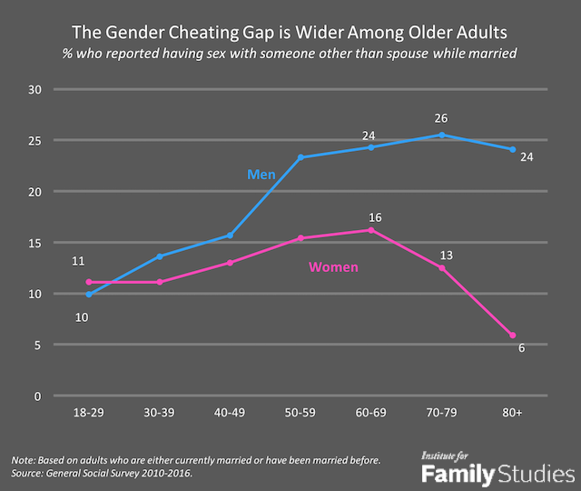
This line graph is based on data collected from adults who are either currently married or have been married before
The general social survey was done from 2010 to 2016

Slide 4

According to the study, American’s Generation Gap in Extramarital Affairs,
20% of older couples noted that they had cheated during their marriage.
About 14% of couples under the age of 55 reported adultery in their marriage.
Most people who cheat have been married for 20 to 30 years and are between the age of 50 and 60.

Slide 5

When a person engages in extramarital affairs, irrespective of the length of involvement in such an activity and whether or not the spouse is aware of it, the mutual 'trust' in 'sexual fidelity' takes an intrinsic blow. However, most people are unaware of the factors that most contribute to infidelity. This investigation seeks to enlighten people on the same.

Slide 6
General Objective
To determine what factor(s) contribute(s) to an individual having an extramarital affair.
Specific Objectives
To build a model that predicts the state of an extramarital affair.
To determine if the proportion of males who have extramarital affairs is equal to the proportion of females who have extramarital affairs in the last 12 months.
To determine which age/age bracket has more extramarital affairs.
To investigate which occupation level has the highest number of extramarital affairs.
To investigate which education level has the highest number of extramarital affairs.

Slide 7
To determine what factor(s) contribute(s) to an individual having an extramarital affair.
To determine what factor(s) contribute(s) to an individual having an extramarital affair.
To determine what factor(s) contribute(s) to an individual having an extramarital affair.
The Investigation

Slide 8
Our Investigation involved sourcing data after which we used to come up with statistical information on how much the various variables contribute towards the outcome(an extramarital affair) as well as challenge the information on the article from Lovetoknow. Lovetoknow Corporation operates as an online media company. It provides information and resources on various topics such as beauty and style, business and technology. More information

Slide 9
Research Questions
Is our model accurate in predicting the state of an extramarital affair?
Is the proportion of males who had extramarital affairs equal to the proportion of females who had extramarital affairs in the last 12 months?
Which age/age bracket has more extramarital affairs?
Which occupation level has the highest number of extramarital affairs?
Which education level has the highest number of extramarital affairs?

Slide 10
Materials
Online Articles
Kaggle Datasets
Google Colab
Jira Kanban
Tableau
Google Docs
Google Slides
List of materials used
(all open source)

Slide 11
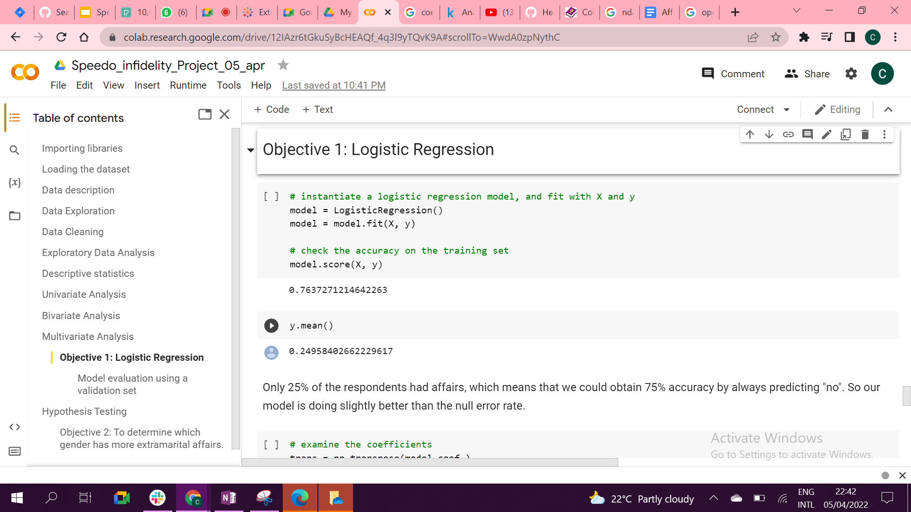
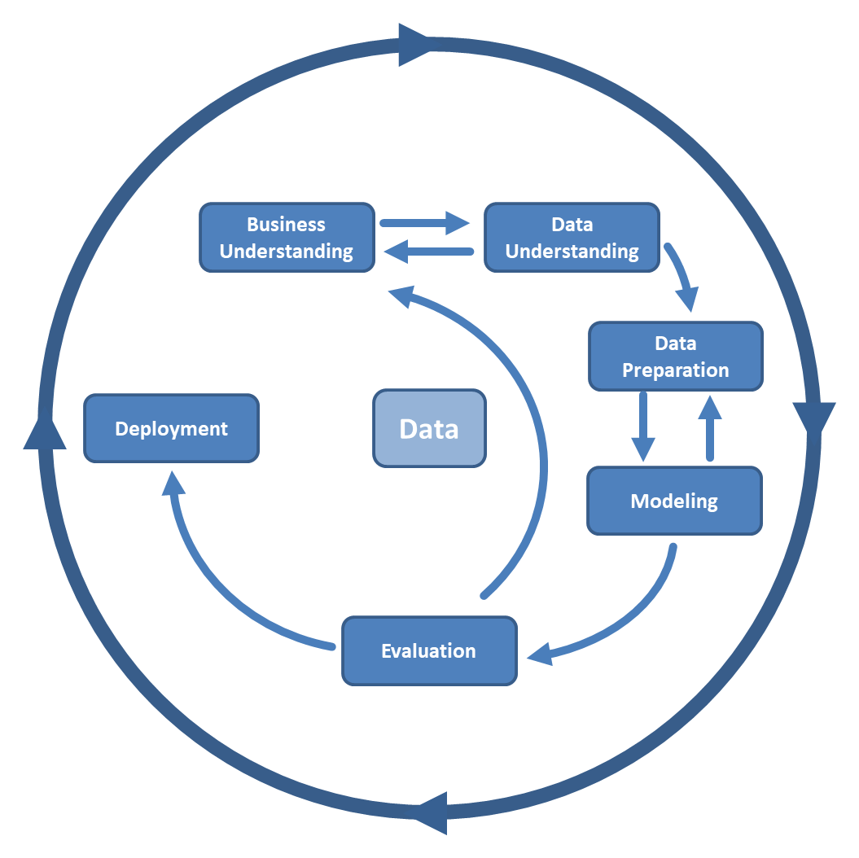
Procedure
Data Sourcing
Business Understanding
Data understanding
Data Preparation
Modeling

Slide 12

We used one dataset with a demographic from the US, obtained from Kaggle. It has 601 numbers of observations and 9 variables. A detailed description of the dataset is provided as follows.:
When preparing the data we Loaded it to google colab and cleaned it using pandas library.The dataset did not have any missing values.
There were also no known data errors in the dataset.
Our data had three numerical variables: Affairs, Age, and years married
It had five categorical variables: Gender, Children, Religiousness, Education, and Occupation
Data construction; we gathered data on income and feature engineered it into the dataset.

Slide 13
Exploratory Analysis

Slide 14
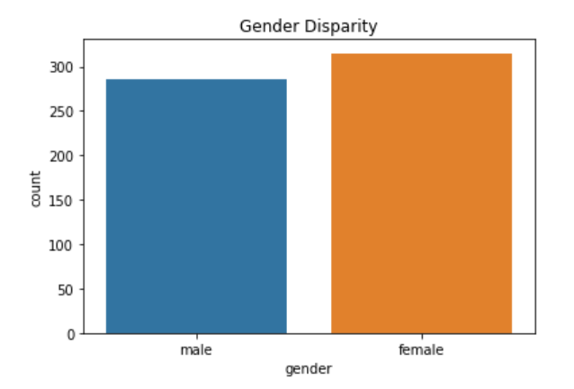
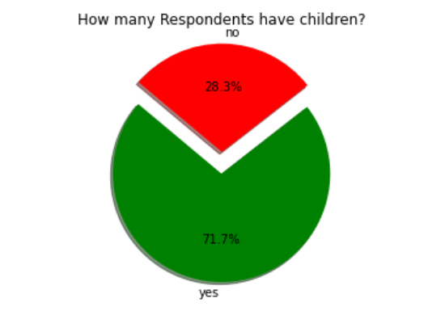
Univariate Analysis
Out of the 601 responses received:
71.7% of the respondents have no children, while 28.3% do have children.
It was noted to have more female than male respondents

Slide 15
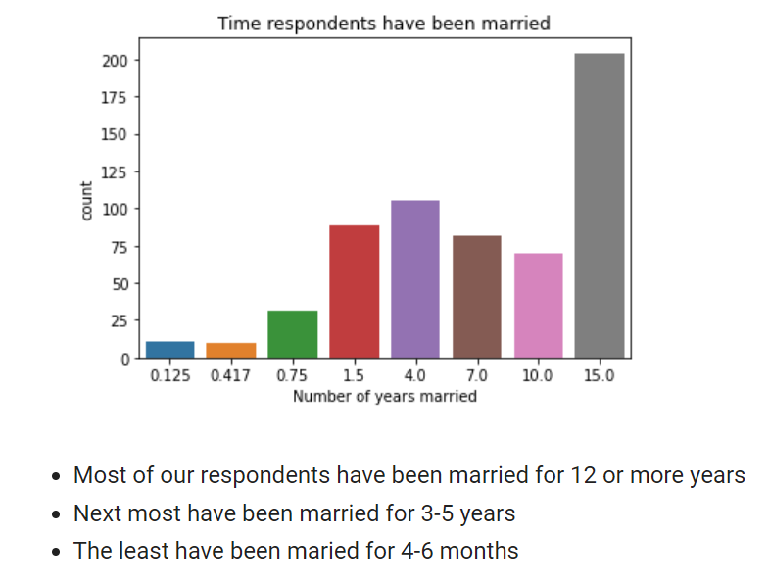
Univariate Analysis
Number of years married:
Key:
0.125= 3 months or less
0.417= 4 - 6 months
0.75= 6 months - 1 year
1.5= 1 - 2years
4.0= 3 - 5 years
7.0= 6 - 8 years
10.0= 9 -11 yrs
15.0= 12 or more years

Slide 16
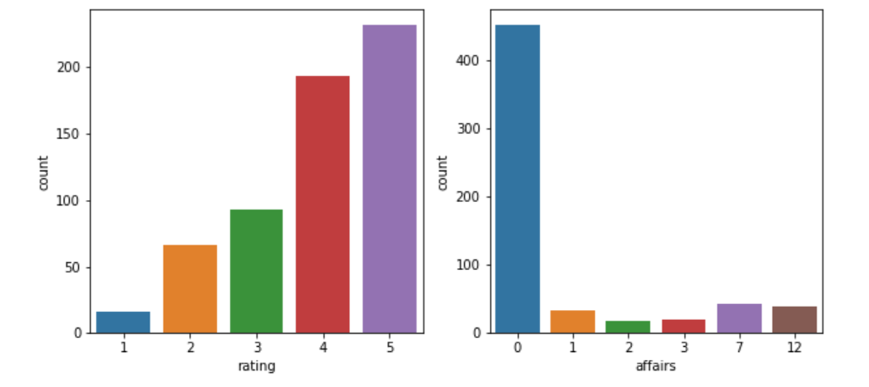
Count plot of Respondents’ marriage rating and Number of Affairs
affairs: Number of affairs
0 = none
1 = once
2 = twice
3 = 3 times
7 = 4-10 times
12 = daily-monthly
rating : How they rate marriage
1 = very poor
2 = poor
3 = fair
4 = good
5 = very good

Slide 17
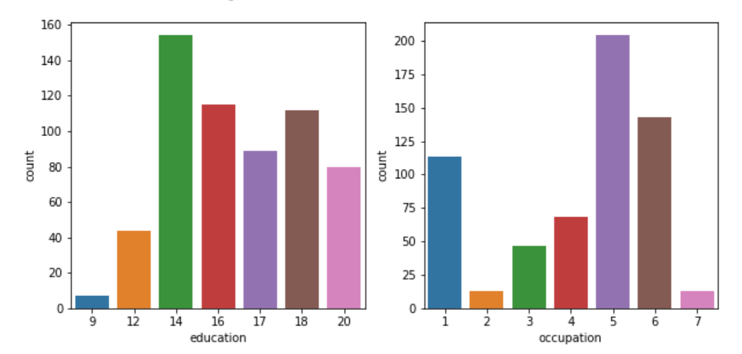
Count of Respondents’ Education Level and Occupation
occupation : Level of occupation
1 = student
2 = farming,agriculture semi-skilled, or unskilled worker
3 = white-collar
4 = teacher, counselor, social worker, nurse; artist,writers;technician, skilled worker
5 = managerial, administrative, business
6 = professional with advanced degree
education: Level of education
9 = grade school
12 = high school
14 = some college
16 = college graduate
17 = some graduate school
20 = advanced degree

Slide 18
Respondents with some college education are the majority
The least being those with grade school as their highest education level
most of the respondents are in managerial and administrative positions as well as business personnel
The second largest portion of the respondents are professionals with advanced degree This discovery suggests that majority of the respondents are literate

Slide 19
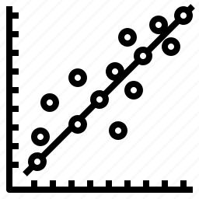
Our conclusion from the correlation matrix
"yearsmarried" and "age" are moderately correlated with r = .78
"education" and "occupation" are also moderately correlated with r = .53
We also look at "affairs" which is not or weakly correlated to the other variables
Bivariate Analysis

Slide 20
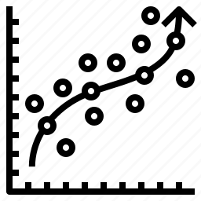
To describe the analysis of data that has multiple variables or observations for each unit or category, we use Multivariate analysis.
First, we treated all the values into categorical variables except the age category.
Our target variable “affairs” was changed into a binary variable stored in the “affairs_bin” column, where ‘0’ represented no extramarital affair and ‘1’ represents presence of an affair regardless of the number of times the affair occurred.
The “affairs” column was thereafter dropped
Dependent and Independent variables were created, i.e
Dependent Variable = “affairs_bin”
Independent Variables = all other columns
Multivariate Analysis

Slide 21
Logistic Regression is one of the models used for multivariate analysis used when it comes to predicting a binary outcome based on prior observations of a dataset. It predicts a dependent data variable by analyzing the relationship between one or more existing independent variables.
Logistic Regression
STEPS TAKEN
Step 1: Splitting the dataset to train and test set
Step 2: Building the logistic regression model
Step 3: Creating predictions on the test dataset
Step 4: Checking the accuracy of the logistic model
Accuracy:
train set accuracy score : 0.75
test set accuracy score : 0.76

Slide 22
Sampling

Slide 23
Sampling Technique
The sampling technique we employed was stratified sampling and the strata was based on gender.
Therefore we had to perform stratified random sampling to avoid bias and give an equal representative sample of both males and females who had affairs since there are more female respondents than male

Slide 24
Hypothesis

Slide 25
Ho: p_male_affairs = p_female_affairs
H1: p_male_affairs ≠ p_female_affairs

Slide 26
Hypothesis support
We think the proportion of females having affairs is equal to proportion of males having affairs because…
It is always assumed that the number of males that engage in extramarital affairs is not equal to females engaging in the same.
The variables that affect the outcome...
Age
Gender
Number of years married
Number of Children
Religious status
Education Level
Occupation

Slide 27
Hypothesis Results
At 95% level of confidence, there is not enough evidence to reject the null hypothesis.
There is not a significant difference between the male proportion that have extramarital affairs and the female proportion that have extramarital affairs.

Slide 28
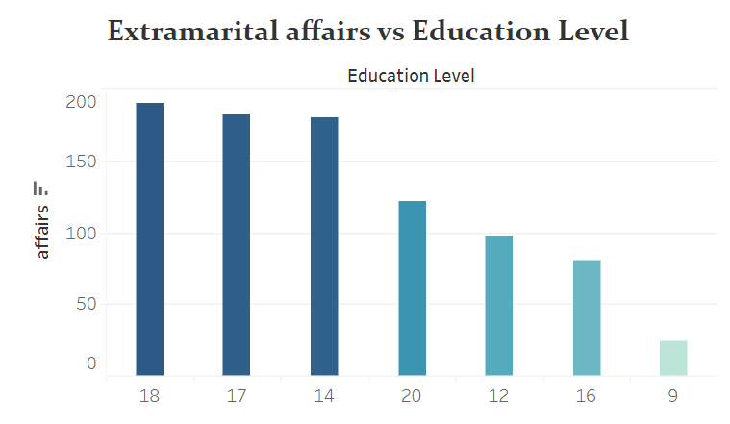
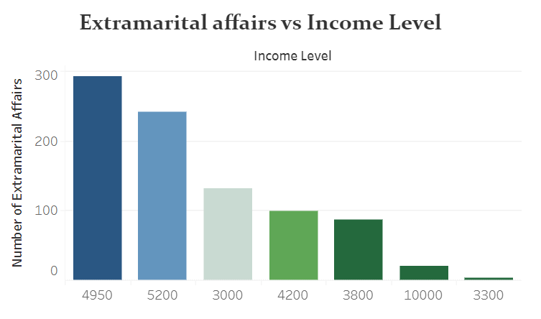
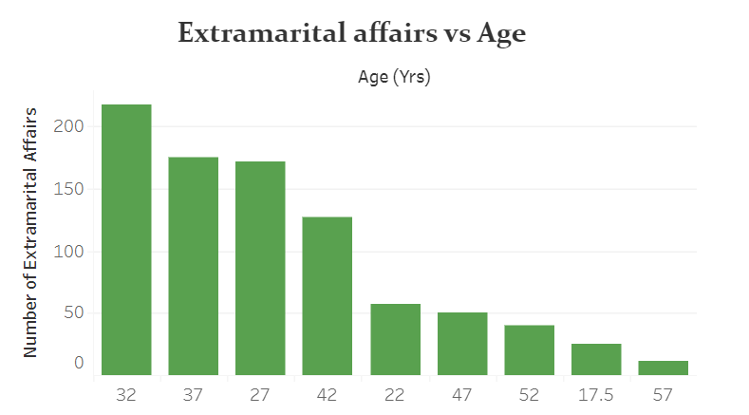
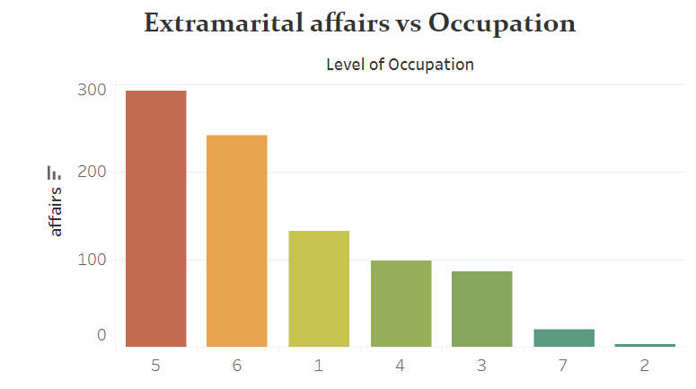

Slide 29
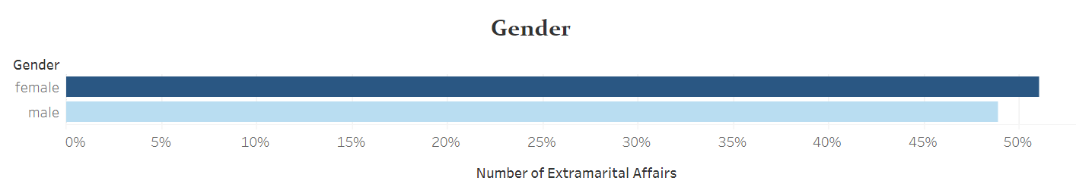

Slide 30
Conclusion
As per our objectives we can conclude that:
There is no significant difference between the male proportion that have extramarital affairs and the female proportion that have extramarital affairs at 51% in the last 12 months.

Slide 31

Recommendations
More data should be collected on extramarital affairs to aid in future analysis.
Data from other parts of the world other than the USA should be collected to provide a broader analysis and insight on extramarital affairs.
Partners who choose to rebuild their relationship after an affair may consider therapy.
Infidelity therapists should use an integrative approach best suited to the couple seeking help from them.

